Slide 1
Lazy Latte Art
Build a latte art machine by April 17, 2023 for $450
Integrated Systems Design II: Milestone 1 Demo
Elise Ferkler, Mariah Tam, Derrick Joyce, Jackie Bendziewicz, Leah Brown, Luke Swetonic
Electrical and Computer Engineering
Clemson University

Slide 2
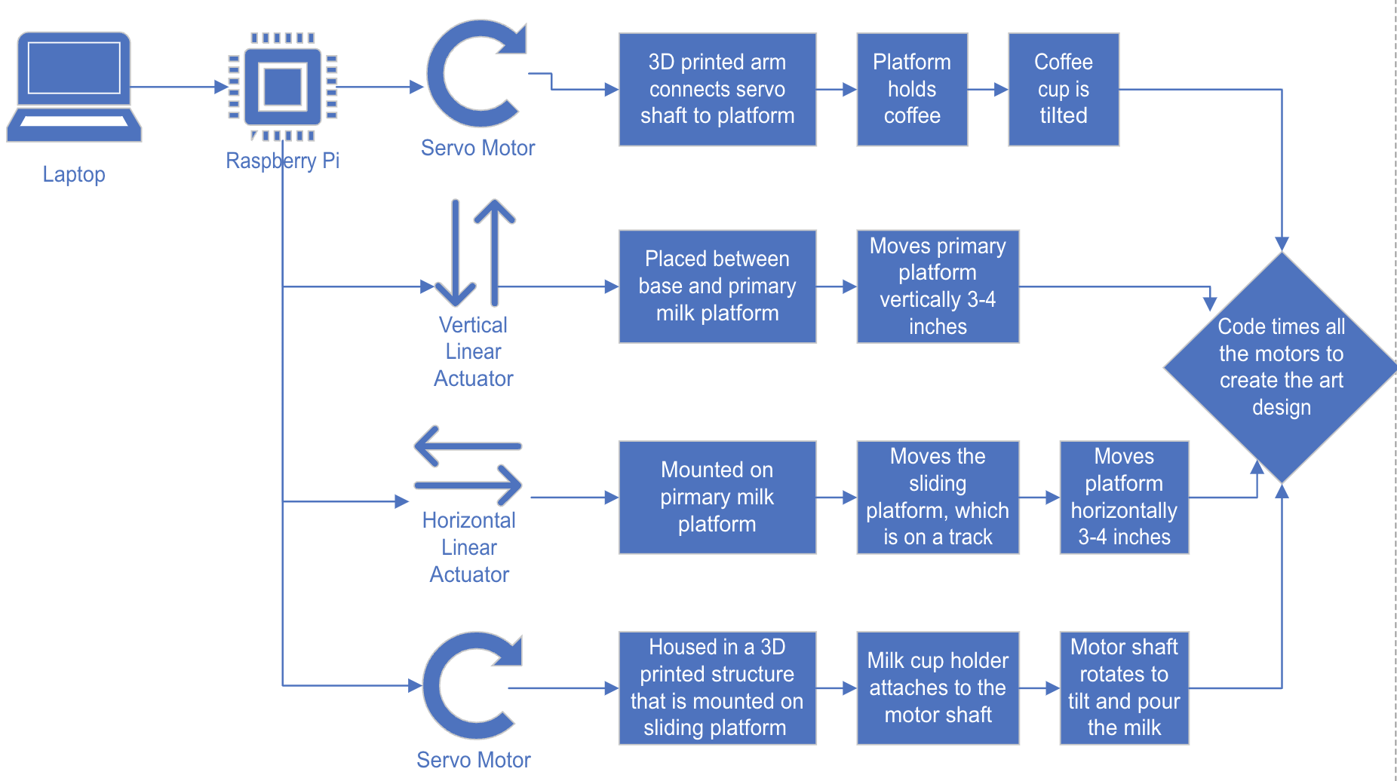
Block Diagram

Slide 3
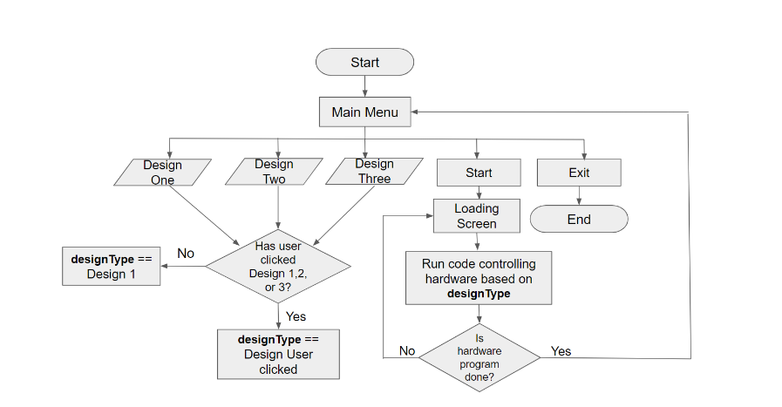
GUI Flow Chart

Slide 4
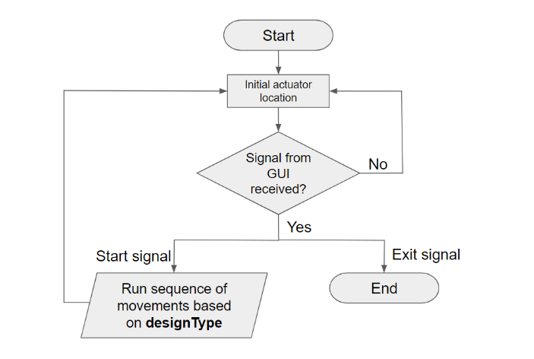
Actuator Control Flow Chart

Slide 5
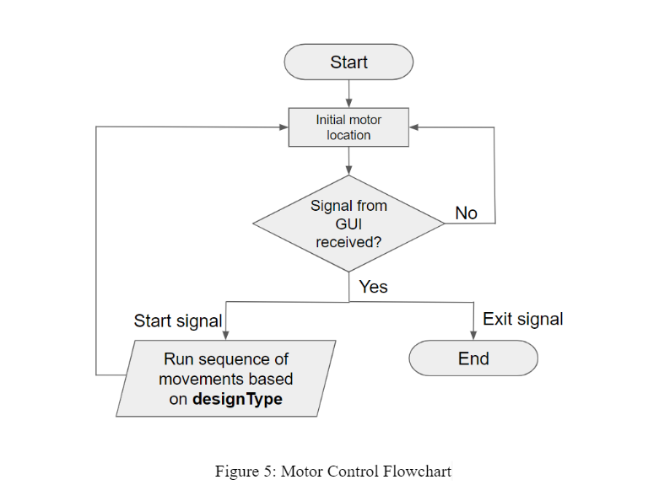
Motor Control Flow Chart

Slide 6
Claimed Deliverables
Create first draft of physical design
Program the 2 linear actuators and 2 servos to move simultaneously
Program the coffee cup servo to rotate from 0 to 45 degrees
Program the milk cup servo to rotate from 0 to 150 degrees
Program the vertical linear actuator to move up 4 inches
Program the horizontal linear actuator to move right 3 inches

Slide 7
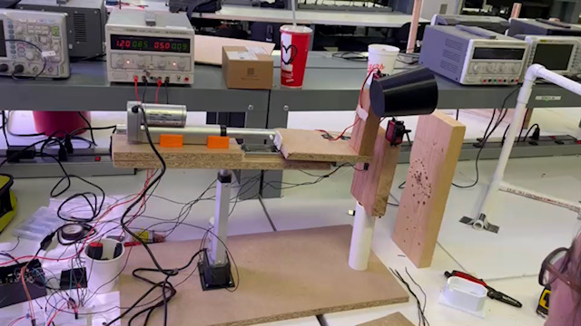
Implemented Prototype

Slide 8
Challenges/Bottlenecks
Twitching servo motors
Precise control of linear actuators
Speed of linear actuators

